Slide 1
Learnev
Educational platform with courses

Slide 2

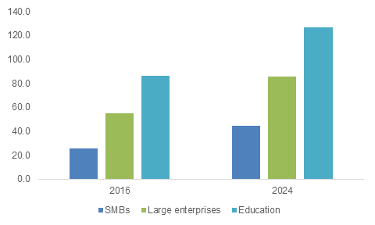
The illiterate of the 21st century will not be those who cannot read and write, but those who cannot learn, unlearn, and relearn. ― Alvin Toffler

Slide 3

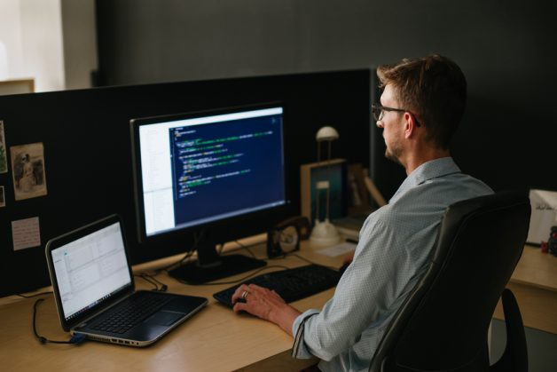
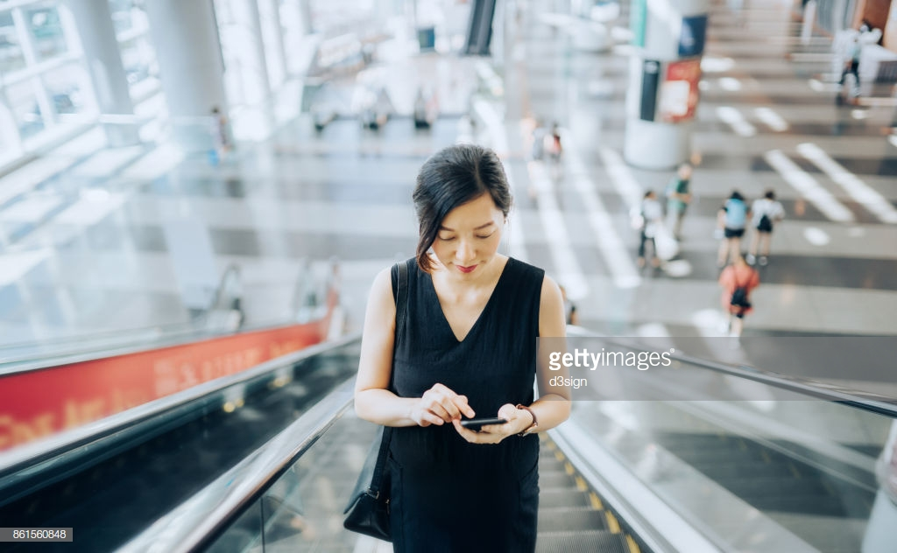

Banker from Zurich
Silicon ValleyProgrammer
Ordinary Beijing woman
American teenagers

Slide 4
What does connect them?

Slide 5


Our competitors
Main weakness of these projects:
1. Can’t add your custom course
2. Small number of available courses
3. Without contact with tutor and other students

Slide 6



Where money comes from?
Advertising
Premium account
Paid subscription

Slide 7
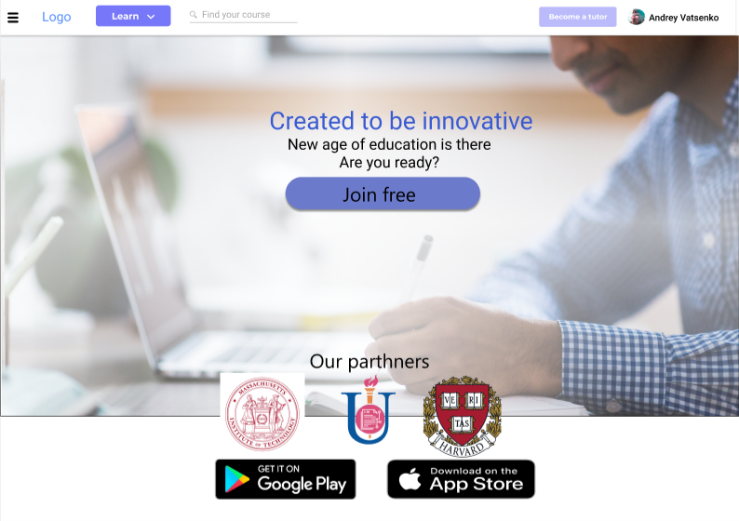
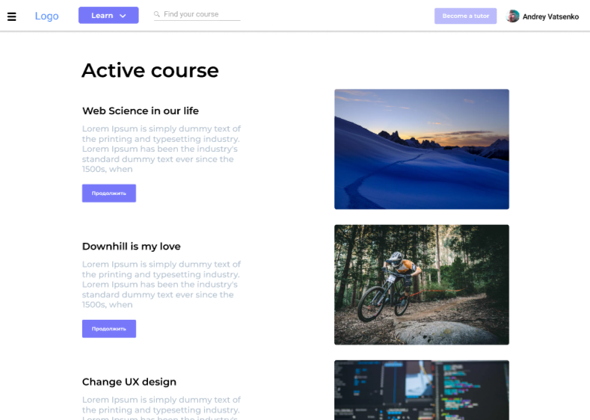
Web version

Slide 8
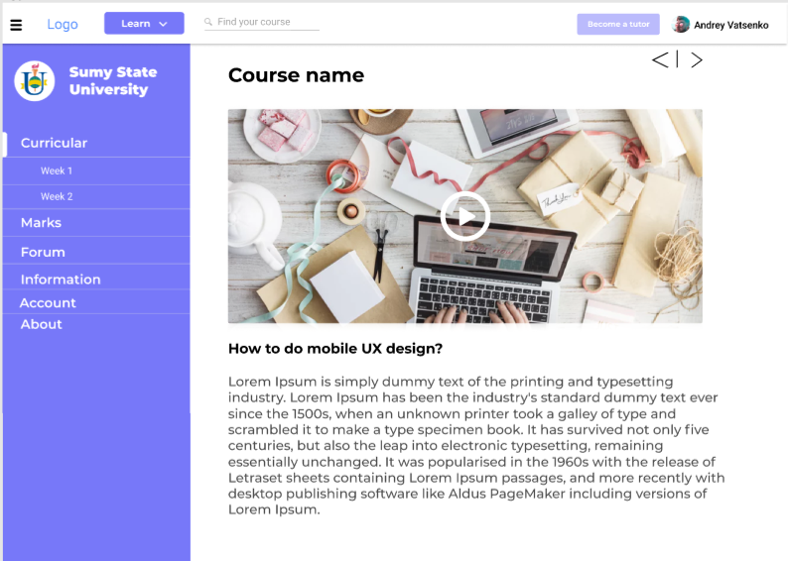

Slide 9
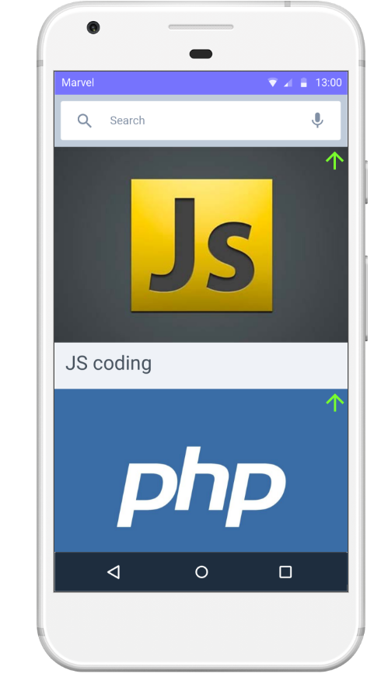
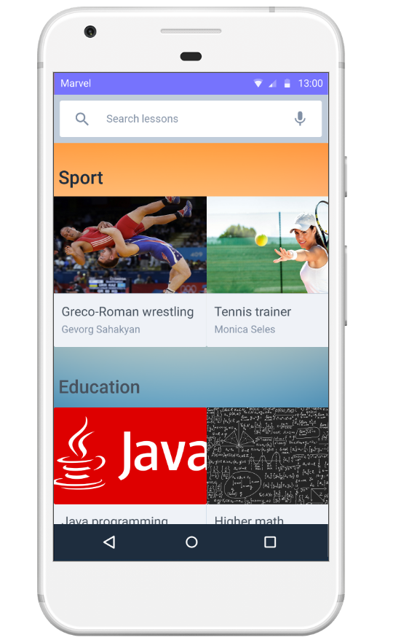
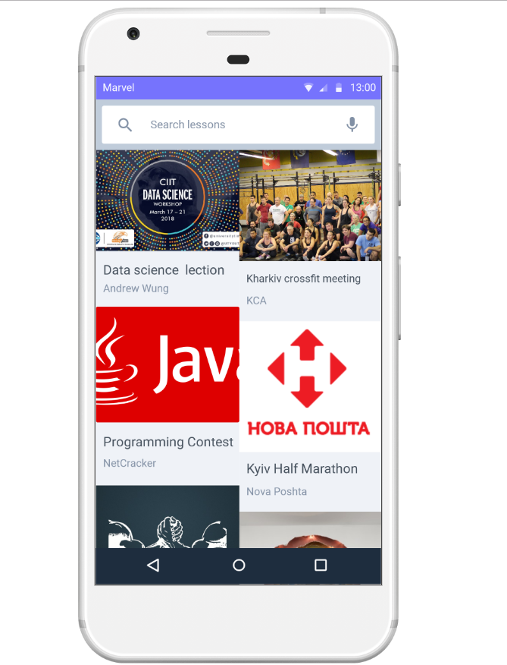
Mobile version

Slide 10
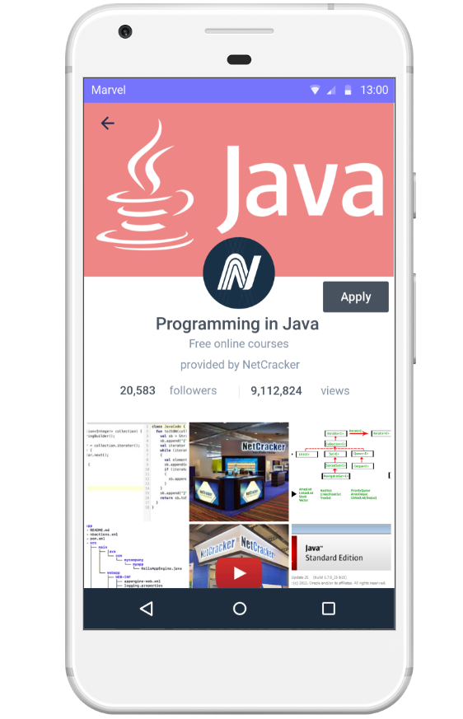
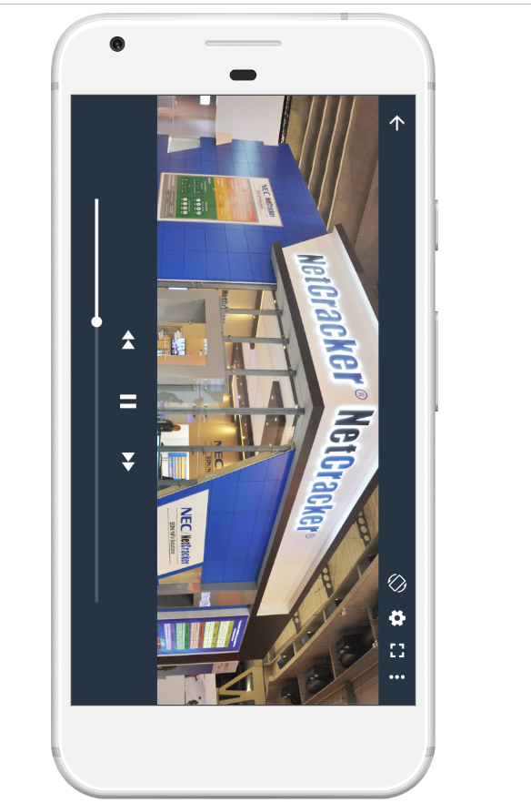

Slide 11
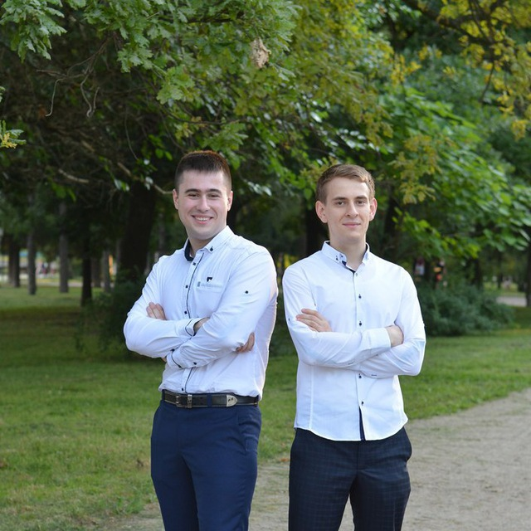
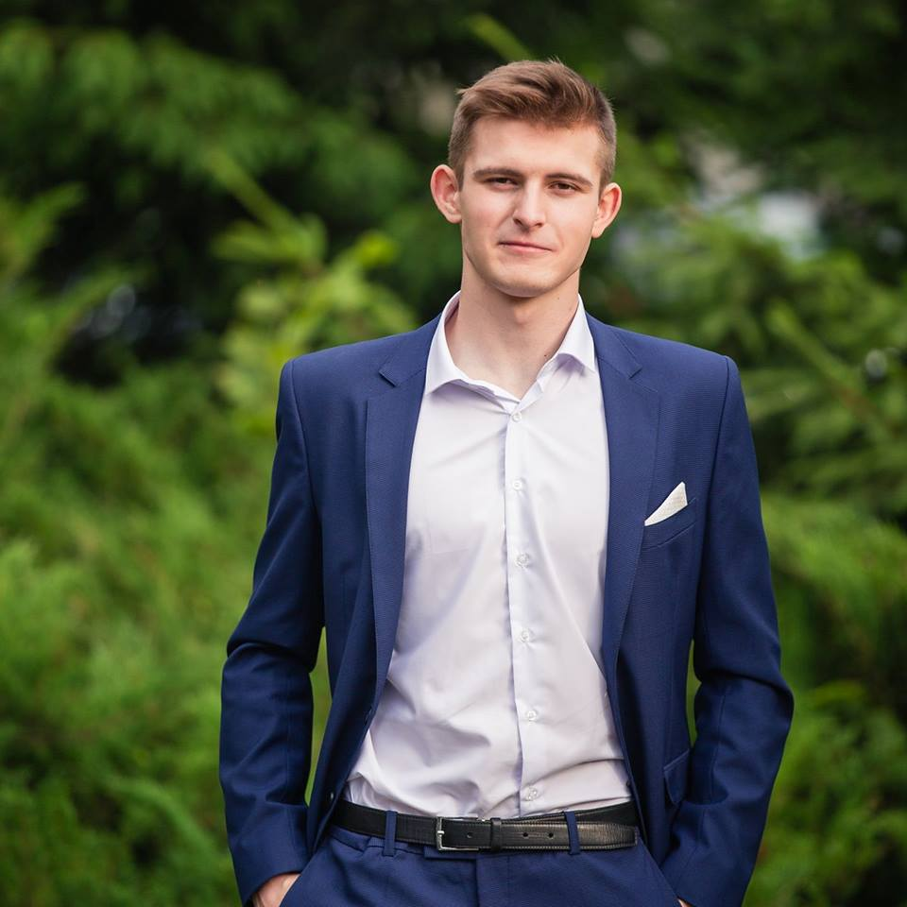
Our team
Mike Birintsev
Vatsenko Andee
Telegram:@Jikes
Telegram:@AndeeVacik

